Slide 1



Slide 2
Culture
Dr. Nandini N
Assistant Professor
Department of Post Graduate Studies in Education
Vijaya Teachers College
Jayanagar, Bangalore

Slide 3

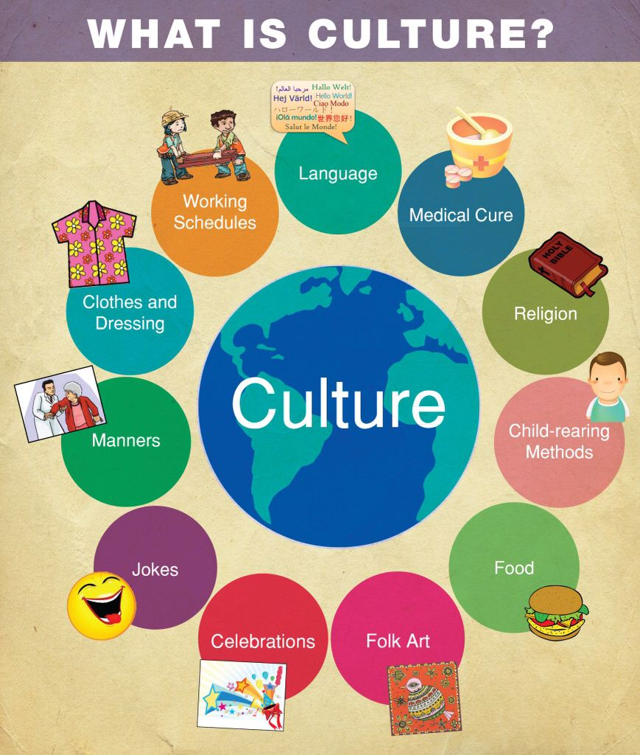
Content
Introduction
Meaning and concept of Culture
Definition of Culture
Characteristics of Culture
Effects of Culture on Society
Conclusion
Summary

Slide 4
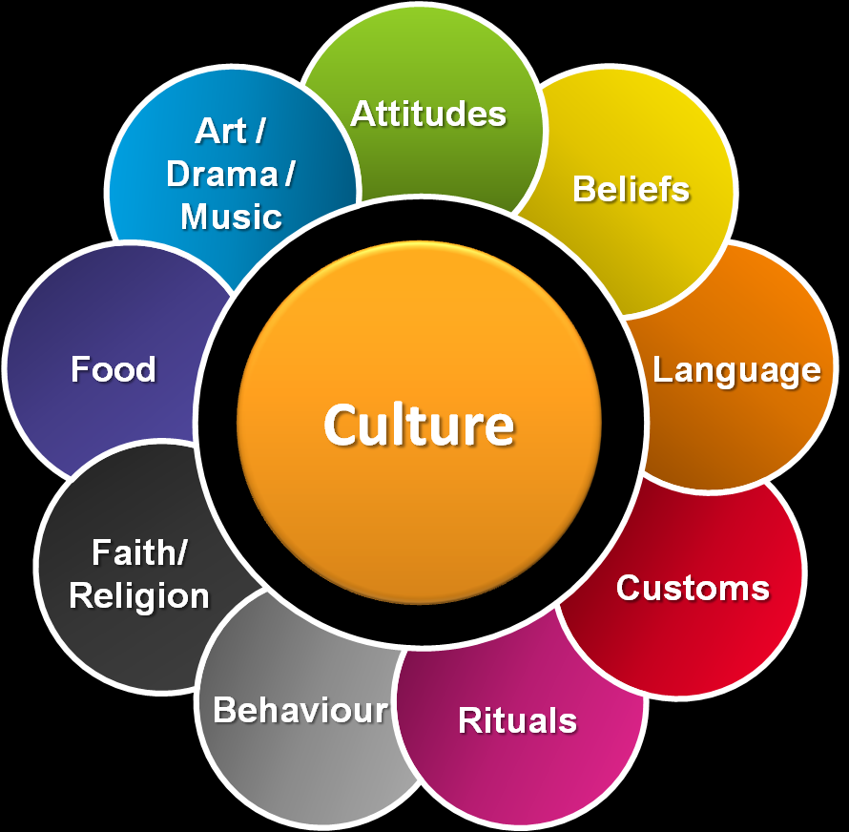
Introduction
Culture is the characteristic of group of people defined by everything such as language, religion, lifestyle etc.
Different people in different societies have different culture but they also have some similarities.
The culture varies in different things such as clothes, foods, religion and many others.

Slide 5

Contd…
The origin of the Latin word cultura is clear.
It is a derivative of the verb colo (infinitive colere),meaning “to tend,” “to cultivate,” and “to till,” among other things.

Slide 6

Meaning and concept of Culture
It can take objects such as ager, hence agricultura, whose literal meaning is “field tilling.” Another possible object of the verb colo is animus (“character”).

Slide 7

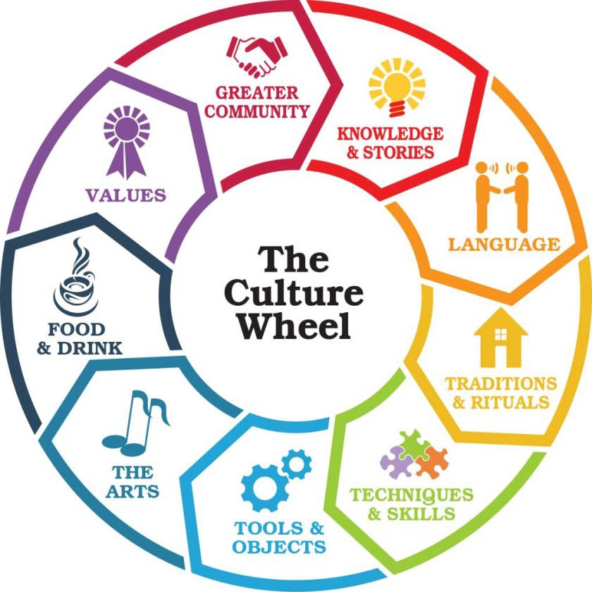
Contd...
In that case, the expression would refer to the cultivation of the human character.
Consequently, the Latin noun cultura can be associated with education and refinement.

Slide 8
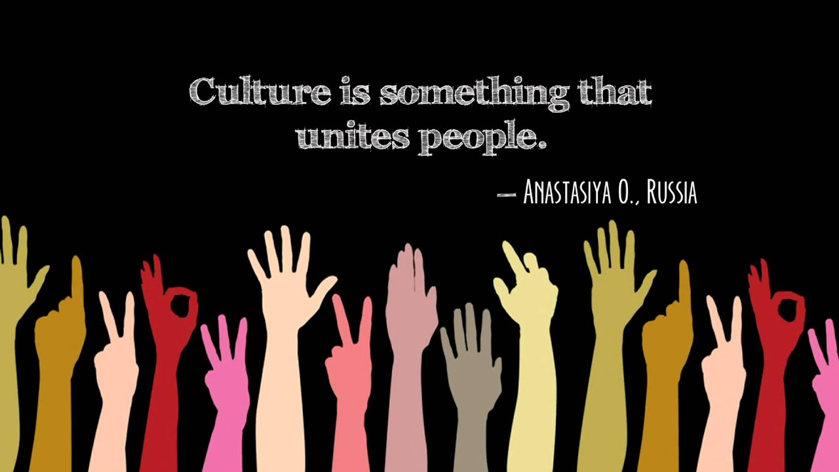
Definition of Culture
Culture is shared mental software, “the collective programming of the mind that distinguishes the members of one group or category of people from another”
Culture is a term that refers to a large and diverse set of mostly intangible aspects of social life.

Slide 9

Contd….
According to sociologists, culture consists of the values, beliefs, systems of language, communication, and practices that people share in common and that can be used to define them as a collective.

Slide 10
Characteristics of Culture
Learned Behaviour
Culture is Abstract
Culture is the Products of Behaviour
Culture is Social
Culture is Adaptive
Culture is shared and transmitted
Culture includes Attitudes, Values Knowledge
Culture is a way of Life
Culture is continuous

Slide 11

Culture is learned behaviour
The definition of culture indicated that the learned behaviour of people is patterned.
Each person’s behaviour often depends upon some particular behaviour of someone else.

Slide 12
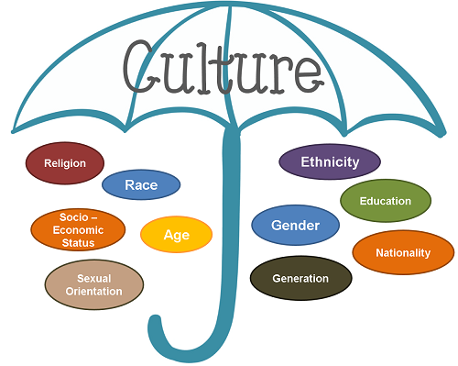
Culture is learned behaviour
The point is that, as a general rule, behaviours are somewhat integrated or organized with related behaviours of other persons.

Slide 13
Culture is Abstract
Culture exists in the minds or habits of the members of society. Culture is the shared ways of doing and thinking.
There are degrees of visibility of cultural behaviour, ranging from the regularised activities of persons to their internal reasons for so doing.
In other words, we cannot see culture as such we can only see human behaviour.
This behaviour occurs in regular, patterned fashion and it is called culture.

Slide 14
Culture is the Products of Behaviour
Culture learnings are the products of behaviour.
As the person behaves, there occur changes in him.
He acquires the ability to swim, to feel hatred toward someone, or to sympathize with someone.
They have grown out of his previous behaviours.

Slide 15

Culture is Social
Culture is a group product developed by many persons interacting in a group.
It is social due to man’s natural tendency of sociability and gregariousness.

Slide 16

Culture is Adaptive
All culture is dynamic.
They change over time.
These changes may be in form of discoveries, inventions, or cultural borrowings.

Slide 17
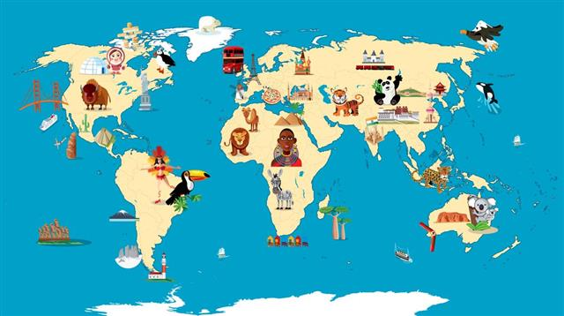
Culture is shared and transmitted
The patterns of learned behaviour and the results of behaviour are possessed not by one or a few person, but usually by a large proportion.

Slide 18
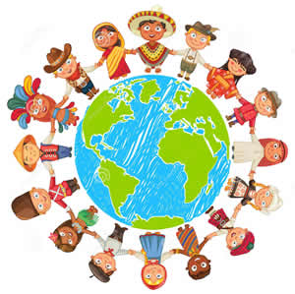
Culture is shared and transmitted
Thus, many millions of persons share such behaviour patterns as Christianity, the use of automobiles, or the English language.

Slide 19
Culture is shared and transmitted
Persons may share some part of a culture unequally. For example, as Americans do the Christian religion.
To some persons Christianity is the all important, predominating idea in life.
To others it is less preoccupying/important, and to still others it is of marginal significance only.

Slide 20
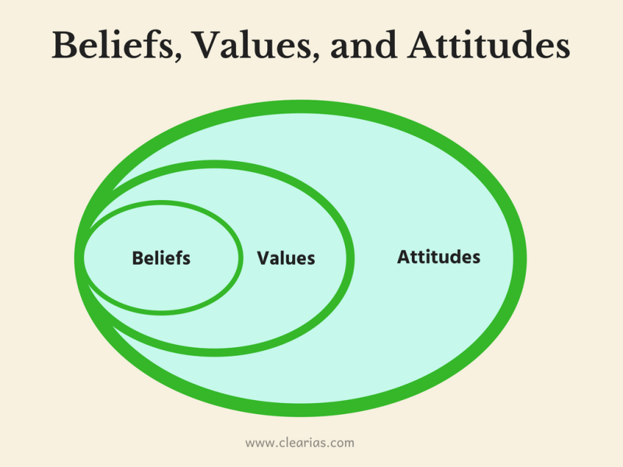
Culture includes Attitudes, Values Knowledge
There is widespread error in the thinking of many people who tend to regard the ideas, attitudes, and notions which they have as “their own”.
It is easy to overestimate the uniqueness of one’s own attitudes and ideas.

Slide 21
Contd….
When there is agreement with other people it is largely unnoticed, but when there is a disagreement or difference one is usually conscious of it.
Your differences however, may also be cultural.
For example, suppose you are a Catholic and the other person a Protestant.

Slide 22
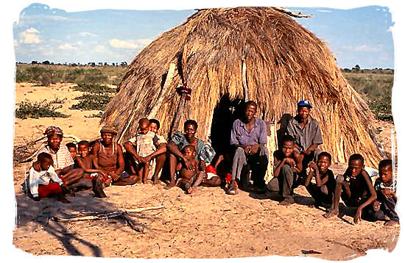
Culture is a way of Life
Culture means simply the “way of life” of a people or their “design for living.” Kluckhohn and Kelly define it in his sense, ”

Slide 23
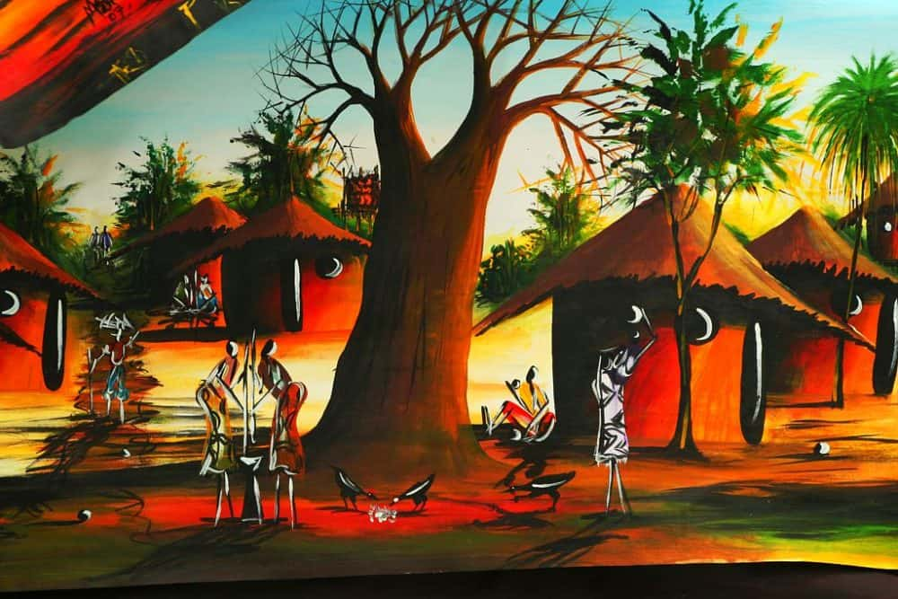
Contd….
A culture is a historically derived system of explicit and implicit designs for living, which tends to be shared by all or specially designed members of a group.”

Slide 24
Contd…
Explicit culture refers to similarities in word and action which can be directly observed.
For example, the adolescent cultural behaviour can be generalized from regularities in dress, mannerism and conversation.
Implicit culture exists in abstract forms which are not quite obvious.

Slide 25

Culture is continuous
Culture is a continuous process and adapts changes in the environment.
Culture is growing whole with the achievements of the past and present and provide the future achievements of mankind.
Culture is the result of past and present experiences.

Slide 26
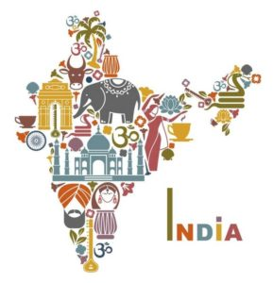
Effects of Culture on Society
Since the beginning of the civilization culture has strong effects on the society.
Scientists, various experts and specialists want to answer how exactly one culture can affect our modern society.
Culture is a part of our lives and defines the nation as it is.

Slide 27
Effects of Culture on Society
Culture is actually a group of people that belongs to a particular society.
The combination of one culture and society makes one country and nation that live in that country.
Culture is the identity of the nation which makes it unique. Culture is the basic root of any community, which teaches us to think for the
whole nation not individually.
Culture gives the concept of family and nation.

Slide 28
Types of Culture
Material Culture
Non-material Culture
Real Culture
Ideal Culture

Slide 29
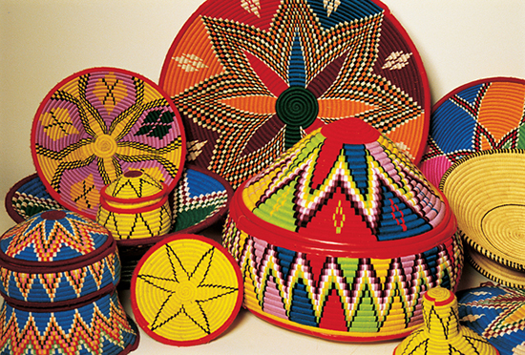
Material Culture
From material culture we understand material and physical objects.
For instance, house, road, vehicles, pen, table, radio set, book etc. these are the products of human efforts to control his environment and make his life conformable and safe

Slide 30
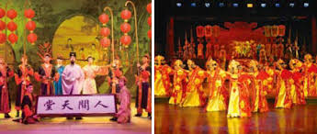
Non-Material Culture
In non-material culture we include non material objects.
For example religion, art, ideas, customs, values system, attitudes, knowledge etc. it does not have physical shape. It is very important in determining human behavior and has strong hold on an individual.
Both parts are inter-related with each other.

Slide 31
Real Culture
Real culture is that which can be observed in our social life.
The culture on which we act upon in our daily life is real culture.

Slide 32

Contd….
It is that parts of culture, which the people adopt in their social life, for example. If a person/ says that he/she is Muslim, will be, when followed all the principles of Islam is the real and when doesn’t follow, is not a real one.

Slide 33

Ideal Culture
The culture which is presented as a pattern to the people is called ideal culture.
It is the goal of society and never achieved fully because some parts remain out of practice.
This culture is explained in books, speeches etc.

Slide 34
Summary
Culture is an umbrella term which encompasses the social behaviour and norms found in human societies, as well as the knowledge, beliefs, arts, laws, customs, capabilities, and habits of the individuals in these groups.
Culture is considered a central concept in anthropology, encompassing the range of phenomena that are transmitted through social learning.

Slide 35
Contd…
Culture is the basic root of any community which gives them the ways of life.
The culture provides solution to the critical problem that is faced to community.
Culture teach us to think for the whole nation not individually, it provide the concept of family, nation etc.

Slide 36
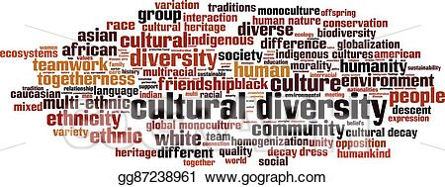
Conclusion
With all this it can be concluded that culture is the identity of a group of people living in specific place, they have their own sketch of life what the culture says they follow that.
We have seen that a lot of people do some specific thing they first thought about their culture, what my culture says on this occasion.

Slide 37
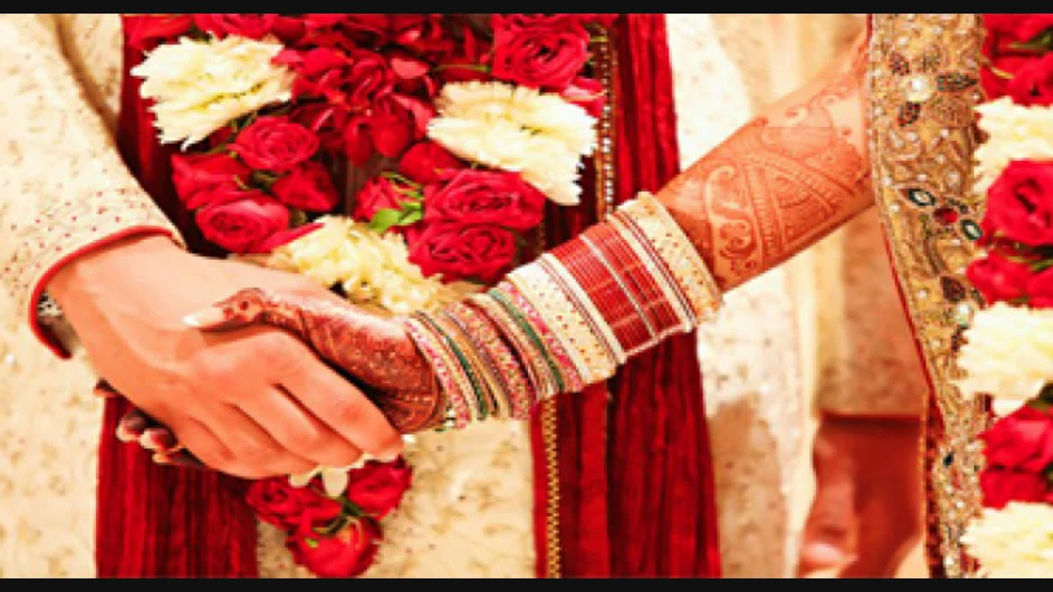
Contd….
Especially on the occasion of wedding, and some other celebrating days they follow strictly their culture.
Those who do not follow their culture or do some changes in that, they haven’t give any values to them because they are not following their religion.

Slide 38
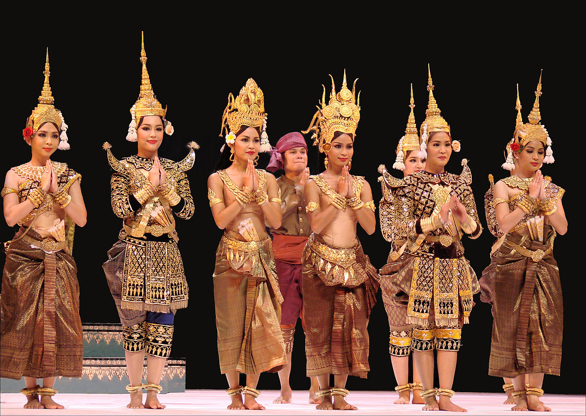
Contd…
Culture has great importance.
Culture is the identity of the nation, without culture the society is impossible.

Slide 39
Contd…
An author says about the importance of culture that “culture is the set of transmitted and learned behavior patterns, beliefs, institutions and all other products of human work and thought that characterize the functioning of particular population, profession, organization or community”, so the only representative of the particular community or population is the culture.

Slide 40



